Slide 1
Modul 9b Digitale Editorik
RDF/XML
Dr. Jaap Geraerts

Slide 2
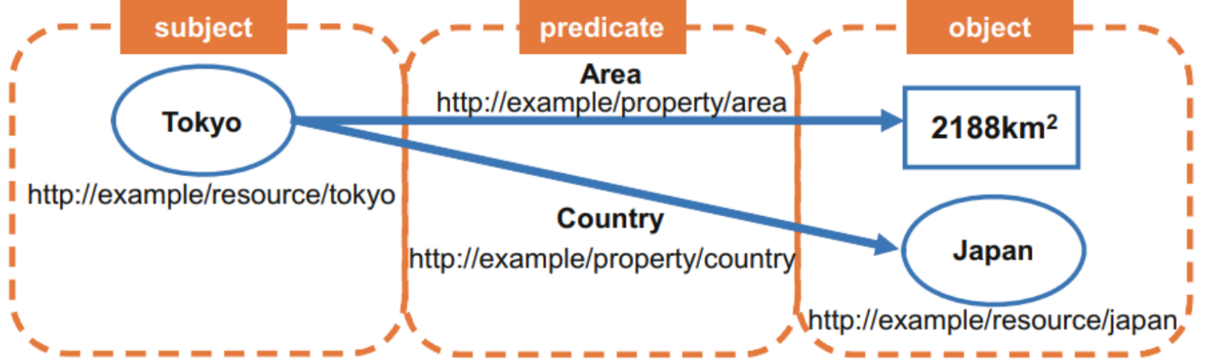
Resource Description Framework (RDF)
RDF is a data model (specific way to describe and organize data)
RDF is XML
RDF has several ‘serializations’ (e.g. RDF XML, Turtle)
Based on ‘triples’
Subjects can be objects of other statements, and vice versa
Source: click here.

Slide 3
RDF/XML
RDF Resource, Property, and Property Value
RDF identifies things using Web identifiers (URIs), and describes resources with properties and property values.
A Resource is anything that can have a URI, such as "https://www.w3schools.com/rdf"
A Property is a Resource that has a name, such as "author" or "homepage"
A Property value is the value of a Property, such as "Jan Egil Refsnes" or "https://www.w3schools.com" (note that a property value can be another resource)
(source: https://www.w3schools.com/xml/xml_rdf.asp)

Slide 4
RDF/XML
“A recipe has the name XXX” (recipe = subject; has the name = predicate, XXX = object)
<rdf:rdf xmlns:rdf="http://www.w3.org/1999/02/22-rdf-syntax-ns#" xmlns:recipe="http://jg.dhlab.de/Teaching/recipe.xsd">
<description about= "recipe" name= "Apple pie" /> <!-- description of resource defined in the about attribute; name as property-->
</rdf>
<rdf:rdf xmlns:rdf="http://www.w3.org/1999/02/22-rdf-syntax-ns#" xmlns:recipe="http://jg.dhlab.de/Teaching/recipe.xsd">
<description about= "recipe" >
<recipe:name= "Apple pie" /> <--different way to define a property of the resource-->
</description>
</rdf>
<rdf:rdf xmlns:rdf="http://www.w3.org/1999/02/22-rdf-syntax-ns#" xmlns:recipe="http://jg.dhlab.de/Teaching/recipe.xsd">
<description about= "recipe" >
<recipe:name>Apple pie</recipe:name>
<recipe:ingredient>Apple</recipe:ingredient>
</description>
</rdf>

Slide 5
RDF/XML (2)
Shakespeare (subject) created (predicate) Two noble kingsmen
<rdf:RDF xmlns:rdf="http://www.w3.org/1999/02/22-rdf-syntax-ns#" <!-- xmlns:rdf namespace, specifies that elements with the rdf prefix are from the namespace "http://www.w3.org/1999/02/22-rdf-syntax-ns#“→
xmlns:dc="http://purl.org/dc/terms/"> <!--xmlns:dc namespace, specifies that elements with the dc prefix are from the namespace “http://purl.org/dc/elements/1.1/”, the Dublin Core Metadata Initiative-->
<rdf:Description rdf:about="http://id.loc.gov/authorities/names/no2010025398"> <!-- rdf:about describes the resource (i.e. anything that can have a URI)-->
<dc:creator rdf:resource="http://viaf.org/viaf/96994048"/> <!--object here specified as URI within property tag which contains the predicate (i.e. ‚creator‘)-->
</rdf:Description>
</rdf:RDF>
Source: https://programminghistorian.org/en/lessons/intro-to-linked-data#rdf-and-data-formats

Slide 6
RDF/XML (3)
Jean le Pourceau was born in Andrimont
<rdf:RDF xmlns:rdf="http://www.w3.org/1999/02/22-rdf-syntax-ns#"
xmlns:people= "http://jg.dhlab.de/Teaching/Geburtsbriefe.xsd/people#" <!-- xmlns:rdf namespace, specifies that elements with the rdf prefix are from the namespace "http://www.w3.org/1999/02/22-rdf-syntax-ns#“→
<rdf:Description rdf:about="http://whgazetteer.org/places/12502346/portal"> <!-- rdf:about describes the resource (i.e. anything that can have a URI)-->
<people:name> Jean le Pourceau </people:name>
<action = "born_in"/>
</rdf:Description>
</rdf:RDF>

Slide 7
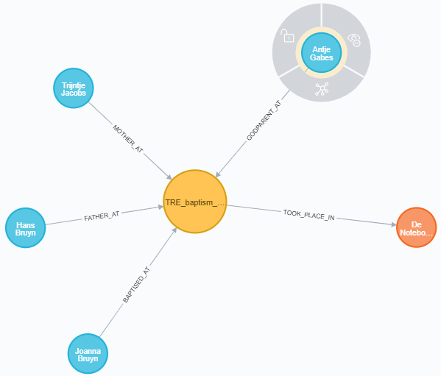
Triple in graph database

Slide 8
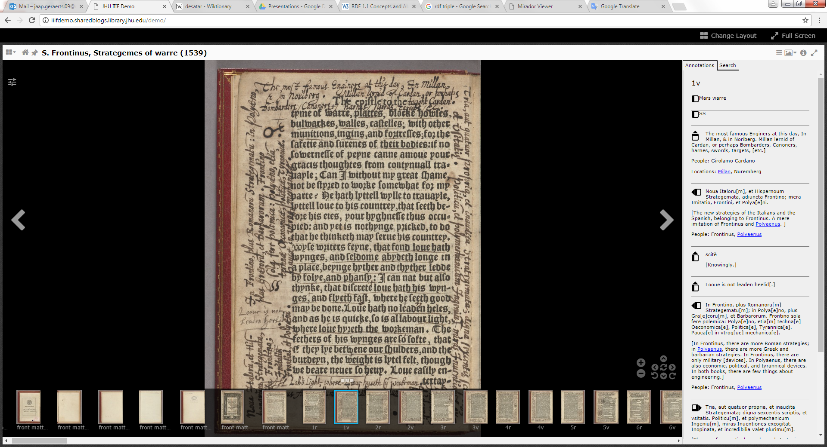
AOR – Perseus example

Slide 9
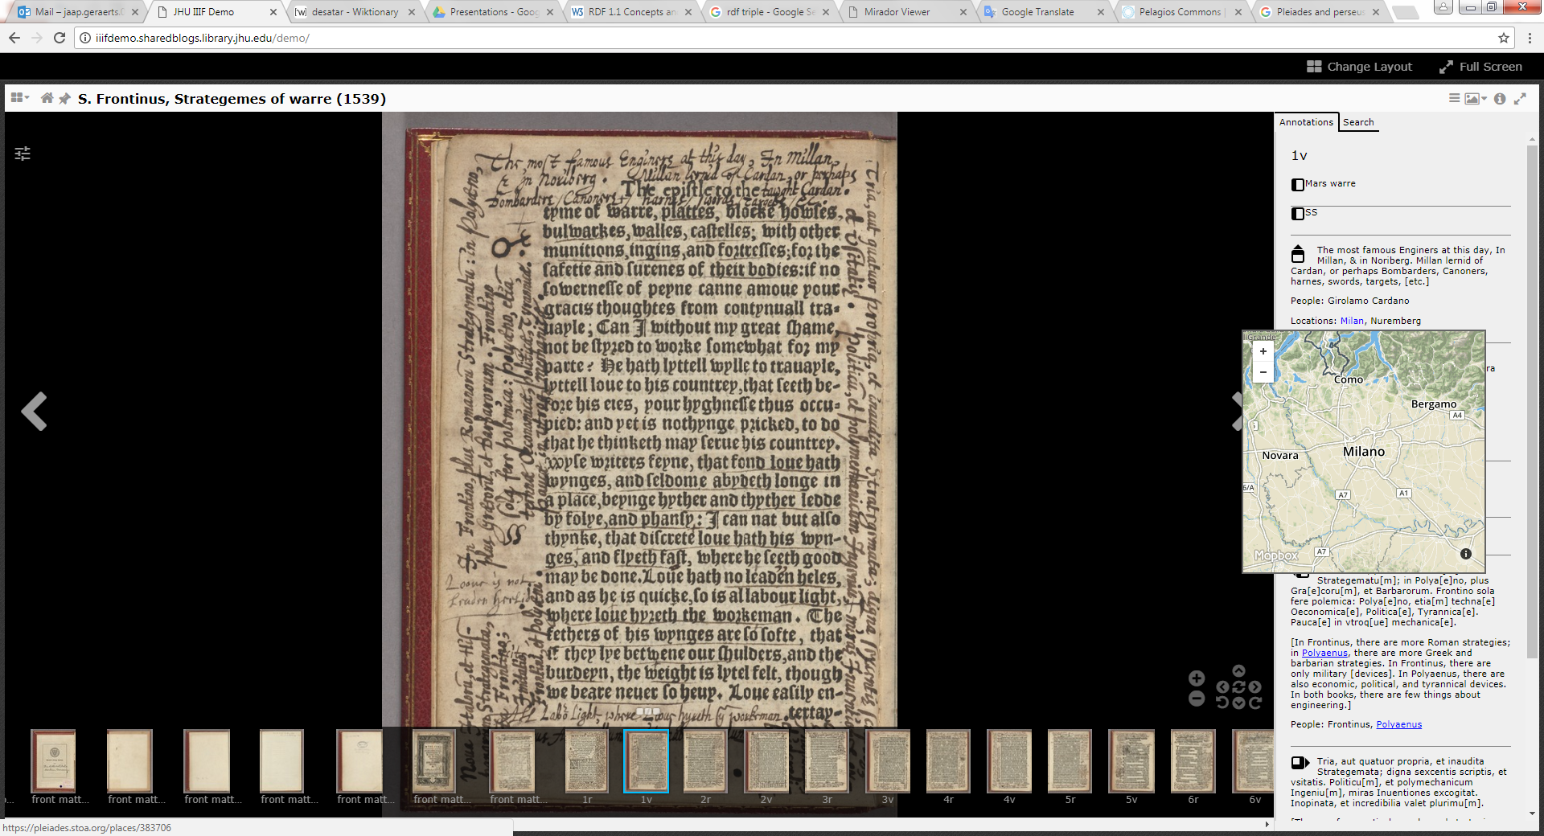
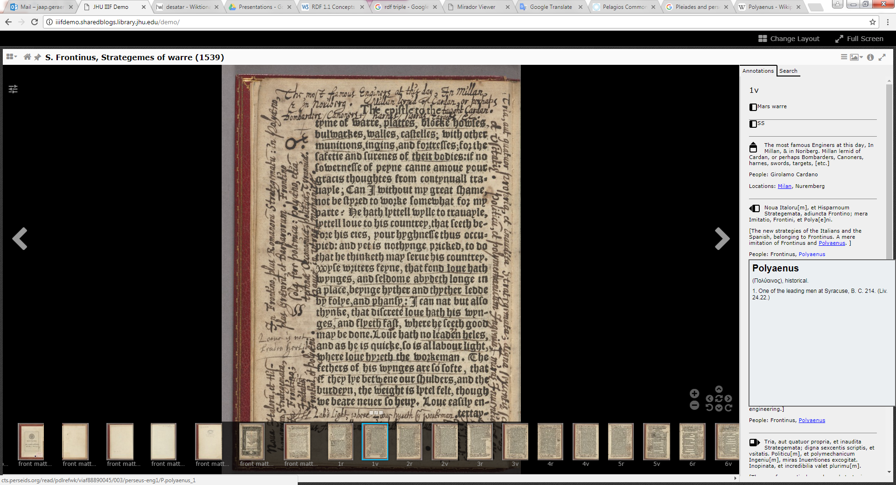
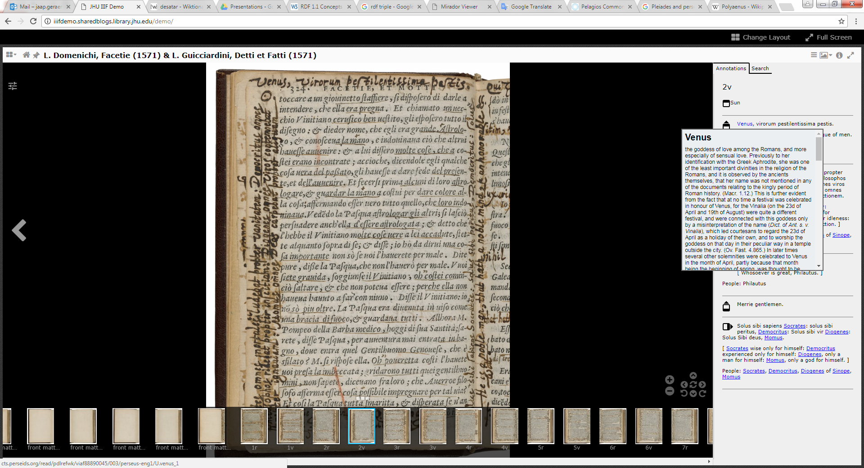
AOR – Perseus example

Slide 10
SPARQL
RDF querying language
Short and nice introduction: https://www.youtube.com/watch?v=FvGndkpa4K0
Tutorial (2): https://www.wikidata.org/wiki/Wikidata:SPARQL_tutorial

Slide 11
Sources
http://www.linkeddatatools.com/introducing-rdf-part-2 (short, but clear introduction to the basics)
http://www.contrib.andrew.cmu.edu/~mm6/95-733/PowerPoint/rdftutorial.pdf
https://www.xul.fr/en-xml-rdf.php#resource
https://www.w3schools.com/xml/xml_rdf.asp
http://wifo5-03.informatik.uni-mannheim.de/bizer/pub/LinkedDataTutorial/
https://programminghistorian.org/en/lessons/intro-to-linked-data
https://www.europeandataportal.eu/sites/default/files/d2.1.2_training_module_1.2_introduction_to_linked_data_de_edp.pdf (useful introduction to Linked Data, in German!)
https://www.uni-ulm.de/fileadmin/website_uni_ulm/iui.inst.090/Lehre/WS_2011-2012/SemWebGrundlagen/v02_handout.pdf (useful introduction to Linked Data, in German!)
https://port.sas.ac.uk/course/view.php?id=54
https://medium.com/wallscope/understanding-linked-data-formats-rdf-xml-vs-turtle-vs-n-triples-eb931dbe9827
https://www.youtube.com/watch?v=zeYfT1cNKQg
Linked Data and AOR: https://www.youtube.com/watch?v=CbW0hjGjjxM&feature=youtu.be

